Slide 1
8
Disk Storage, Basic File Structures, and Hashing

Slide 2
8.1. Physical Storage Systems

Slide 3
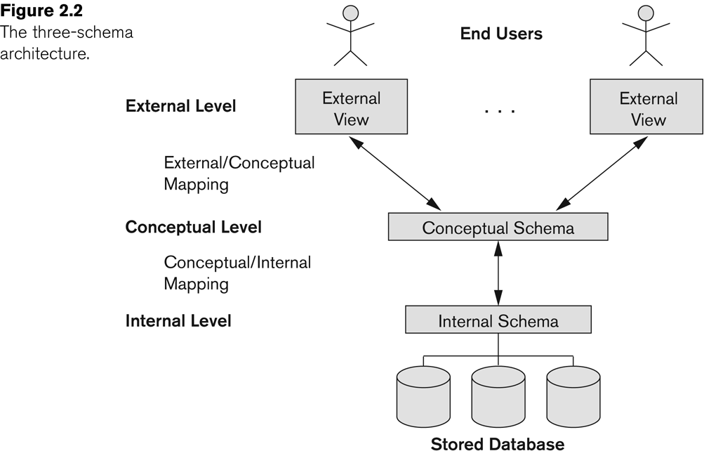
Three-Schema(ANSI-SPARC) Architecture
Notes:
Internal schema at the internal level to describe physical storage structures and access paths .
Typically uses a physical data model.

Slide 4
Classification of Physical Storage Media
Can differentiate storage into:
volatile storage:
loses contents when power is switched off
non-volatile storage:
Contents persist even when power is switched off.
Includes secondary and tertiary storage, as well as batter-backed up main-memory.
Factors affecting choice of storage media include
Speed with which data can be accessed
Cost per unit of data
Reliability

Slide 5
Storage H ierarch y
CPU Registers
Faster Smaller Expensive
Volatile Random Access Byte- Addressable
CPU Caches
DRAM
SSD
Non- Volatile Sequential Access Block- Addressable
HDD
Slower Larger
Cheaper
Network Storage

Slide 6
Storage H ierarch y
CPU Registers
Faster Smaller Expensive
CPU Caches
Memory
DRAM
SSD
Disk
HDD
Slower Larger
Cheaper
Network Storage

Slide 7
Storage Hierarchy (Cont.)
Primary storage: Fastest media but volatile (cache, main memory).
Secondary storage: next level in hierarchy, non-volatile, moderately fast access time
Also called on-line storage
E.g., flash memory, magnetic disks
Tertiary storage: lowest level in hierarchy, non-volatile, slow access time
also called off-line storage and used for archival storage
e.g., magnetic tape, optical storage
Magnetic tape
Sequential access, 1 to 12 TB capacity
A few drives with many tapes
Juke boxes with petabytes (1000’s of TB) of storage

Slide 8
ACCESS TIM ES
For comparison Let 1 ns = 1 sec.
0.5 ns | L1 Cache Ref
7 ns | L2 Cache Ref
100 ns | DRAM
150,000 ns | SSD
10,000,000 ns | HDD
~30,000,000 ns | Network Storage
1,000,000,000 ns | Tape Archives
0.5 sec
7 sec
100 sec
1.7 days
16.5 weeks
11.4 months
31.7 years
[Source]

Slide 9
Jim Gray’s Storage Latency Analogy: How Far Away is the Data?
Andromeda
9
10
Tape /Optical
2,000 Years
Robot
6
Disk
Pluto
2 Years
10
100
Memory
Sacramento
1.5 hr
10
On Board Cache
Lecture Hall
10 min

2
On Chip Cache
This Room

1ns
Registers
My Head
1 min

Slide 10
Secondary Storage Devices
Formatting
Divides tracks into equal-sized disk blocks
Blocks separated by interblock gaps
Data transfer in units of disk blocks
Hardware address supplied to disk I/O hardware
Buffer
Used in read and write operations
Read/write head
Hardware mechanism for read and write operations

Slide 11
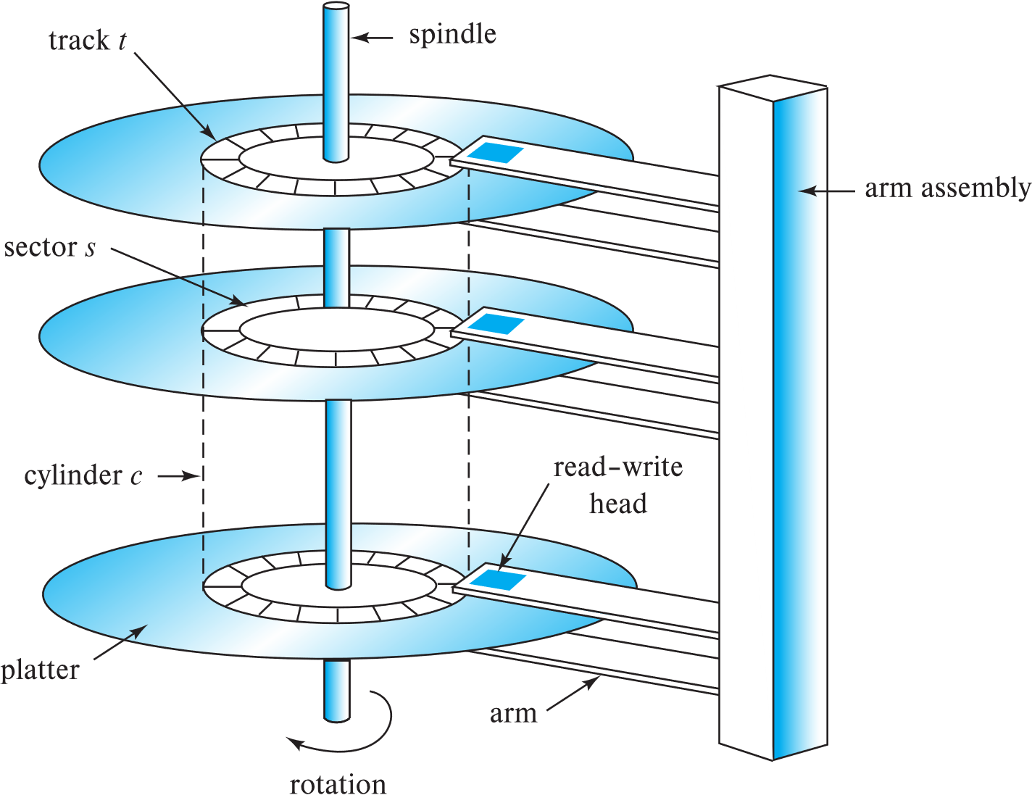
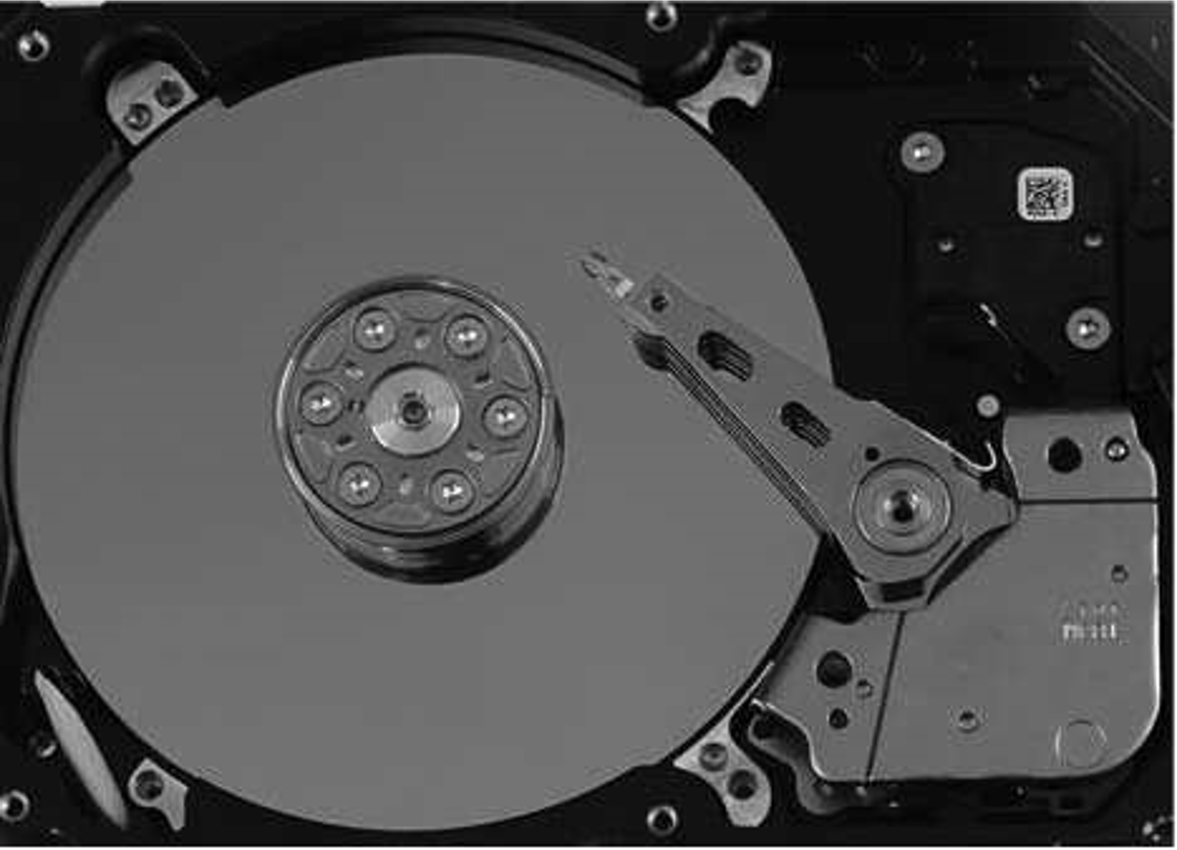
Magnetic Hard Disk Mechanism
Schematic diagram of magnetic disk drive
Photo of magnetic disk drive

Slide 12
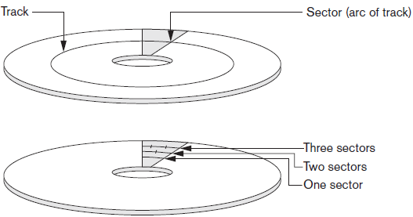
Sectors on a Disk

Slide 13
Magnetic Disks
Read-Write head
Surface of platter divided into circular tracks
Over 50K-100K tracks per platter on typical hard disks
Each track is divided into sectors.
A sector is the smallest unit of data that can be read or written.
Sector size typically 512 bytes
Typical sectors per track:
500 to 1000 (on inner tracks) to 1000 to 2000 (on outer tracks)
Head-disk assemblies
multiple disk platters on a single spindle (1 to 5 usually)
one head per platter, mounted on a common arm.
Cylinder i consists of i^{th} track of all the platters
Notes:
Mention: checksums, bad sector remapping

Slide 14
Magnetic Disks
To read/write a sector
disk arm swings to position head on right track
platter spins continually;
data is read/written as sector passes under head
Notes:
Mention: checksums, bad sector remapping

Slide 15
Magnetic Disks (Cont.)
Disk controller – interfaces between the computer system and the disk drive hardware.
accepts high-level commands to read or write a sector
initiates actions such as moving the disk arm to the right track and actually reading or writing the data
Computes and attaches checksums to each sector to verify that data is read back correctly
If data is corrupted, with very high probability stored checksum won’t match recomputed checksum
Ensures successful writing by reading back sector after writing it
Performs remapping of bad sectors

Slide 16
Performance Measures of Disks
Access time – the time it takes from when a read or write request is issued to when data transfer begins. Consists of:
Seek time – time to reposition the arm over the correct track.
4 to 10 milliseconds on typical disks
Rotational latency – time to put the sector under the head.
4 to 11 milliseconds on typical disks (5400 to 15000 r.p.m.)
Data-transfer rate – the rate at which data can be retrieved from or stored to the disk.
50 to 200 MB per second max rate, lower for inner tracks
Notes:
Seek time – time it takes to reposition the arm over the correct track.
Average seek time is 1/2 the worst case seek time.
Would be 1/3 if all tracks had the same number of sectors, and we ignore the time to start and stop arm movement
4 to 10 milliseconds on typical disks
Rotational latency – time it takes for the sector to be accessed to appear under the head.
4 to 11 milliseconds on typical disks (5400 to 15000 r.p.m.)
Average latency is 1/2 of the above latency

Slide 17
Performance Measures (Cont.)
Disk block is a logical unit for storage allocation and retrieval
4 to 16 kilobytes typically
Smaller blocks: more transfers from disk
Larger blocks: more space wasted due to partially filled blocks
Sequential access pattern
Successive requests are for successive disk blocks
Disk seek required only for first block
Random access pattern
Successive requests are for blocks that can be anywhere on disk
Each access requires a seek
Transfer rates are low since a lot of time is wasted in seeks
I/O operations per second (IOPS)
Number of random block reads that a disk can support per second
50 to 200 IOPS on current generation magnetic disks

Slide 18
Performance Measures (Cont.)
Mean time to failure (MTTF) – the average time the disk is expected to run continuously without any failure.
Probability of failure of new disks is quite low, corresponding to a “theoretical MTTF” of 500,000 to 1,200,000 hours for a new disk (57 to 136 years)
E.g., an MTTF of 1,200,000 hours for a new disk means that given 1000 relatively new disks, on an average one will fail every 1200 hours.
Most disks have an expected life span of about 5 years and have significantly higher rates of failure once they become more than a few years old.
MTTF decreases as disk ages

Slide 19
Solid State Device Storage
Sometimes called flash storage
Main component: controller
Set of interconnected flash memory cards
No moving parts
Data less likely to be fragmented:
any address is directly addressable
Faster in terms of access time and provides higher transfer rates than HDDs
More costly than HDDs
DRAM-based SSDs available: Faster access times than flash

Slide 20
Flash Storage
NAND flash
used widely for storage, cheaper than NOR flash
requires page-at-a-time read (page: 512 bytes to 4 KB)
20 to 100 microseconds for a page read
Not much difference between sequential and random read
Page can only be written once: Must be erased to allow rewrite
Solid state disks
Use standard block-oriented disk interfaces, but store data on multiple flash storage devices internally
Transfer rate of
up to 500 MB/sec using SATA, and
up to 3 GB/sec using NVMe PCIe
Is this always true?

Slide 21
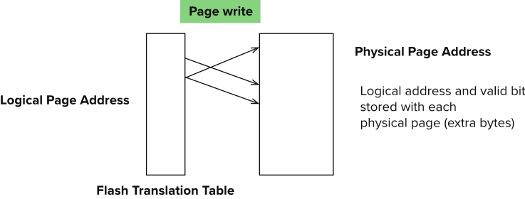
Flash Storage (Cont.)
Erase happens in units of erase block
Takes 2 to 5 millisecs
Erase block typically 256 KB to 1 MB (128 to 256 pages)
Remapping of logical page addresses to physical page addresses avoids waiting for erase
Flash translation table tracks mapping
remapping carried out by flash translation layer
After 100,000 to 1,000,000 erases, erase block becomes unreliable and cannot be used
wear leveling
Notes:
Where is FTL stored? How is it reconstructed on system startup?
How to track number of erases per block (extra storage per block)

Slide 22
SSD Performance Metrics
Random reads/writes per second
Typical 4 KB reads: 10,000 reads per second (10,000 IOPS)
Typical 4KB writes: 40,000 IOPS
SSDs support parallel reads
Typical 4KB reads:
100,000 IOPS with 32 requests in parallel (QD-32) on SATA
350,000 IOPS with QD-32 on NVMe PCIe
Typical 4KB writes:
100,000 IOPS with QD-32, even higher on some models
Data transfer rate for sequential reads/writes
400 MB/sec for SATA3, 2 to 3 GB/sec using NVMe PCIe
Hybrid disks: combine small amount of flash cache with larger magnetic disk
Notes:
QD : Queue depth => refers to the number of outstanding access operations.

Slide 23
Storage Class Memory
3D-XPoint memory technology pioneered by Intel
Available as Intel Optane
SSD interface shipped from 2017
Allows lower latency than flash SSDs
Non-volatile memory interface announced in 2018
Supports direct access to words, at speeds comparable to main-memory speeds

Slide 24
Magnetic Tapes
Hold large volumes of data
Few GB for DAT (Digital Audio Tape) format, 10-40 GB with DLT (Digital Linear Tape) format, 100 GB+ with Ultrium format, and 330 GB with Ampex helical scan format
Transfer rates from few to 10s of MB/s
Tapes are cheap, but cost of drives is very high
Very slow access time in comparison to magnetic and optical disks
limited to sequential access.
Some formats (Accelis) provide faster seek (10s of seconds) at cost of lower capacity
Used mainly for backup, for storage of infrequently used information, and as an off-line medium for transferring information from one system to another.
Tape jukeboxes used for very large capacity storage
Multiple petabyes (10¹⁵ bytes)

Slide 25
Secondary Storage Devices
Disk controller
Interfaces disk drive to computer system
Standard interfaces
SATA
SCSI
SAS
NVMe

Slide 26
SATA
Serial ATA (SATA, abbreviated from Serial AT Attachment) is a computer bus interface that connects host bus adapters to mass storage devices such as hard disk drives, optical drives, and solid-state drives.
Serial ATA succeeded the earlier Parallel ATA (PATA) standard to become the predominant interface for storage devices.
Revisions
Encoding overhead: 8b/10b
SATA revision 1.0
1.5 Gbit/s, 150 MB/s, Serial ATA-150
SATA revision 2.0
3 Gbit/s, 300 MB/s, Serial ATA-300)
SATA revision 3.0
6 Gbit/s, 600 MB/s, Serial ATA-600

Slide 27
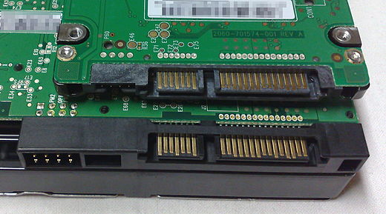

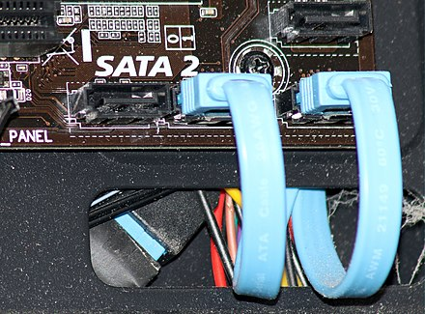
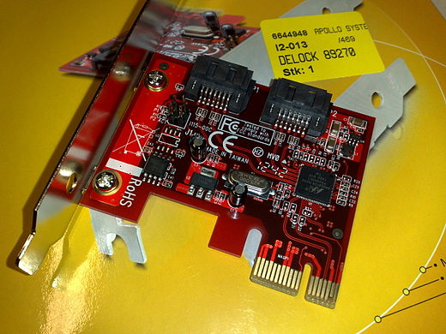
2.5-inch SATA drive on top of a 3.5-inch SATA drive
SATA 3 6 Gbit/s host controller, a PCI Express ×1 card
SATA 2 3 Gbit/s connectors on a computer motherboard

Slide 28
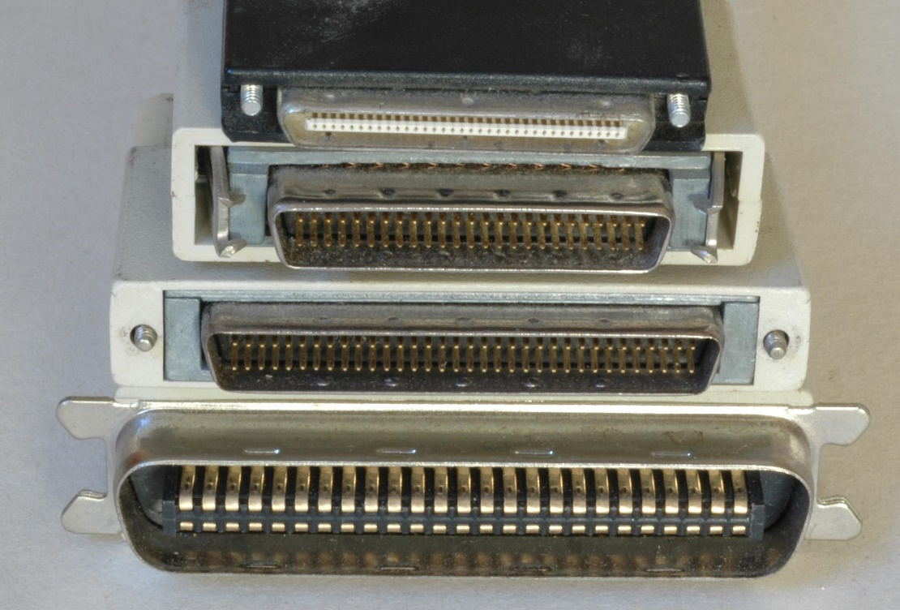
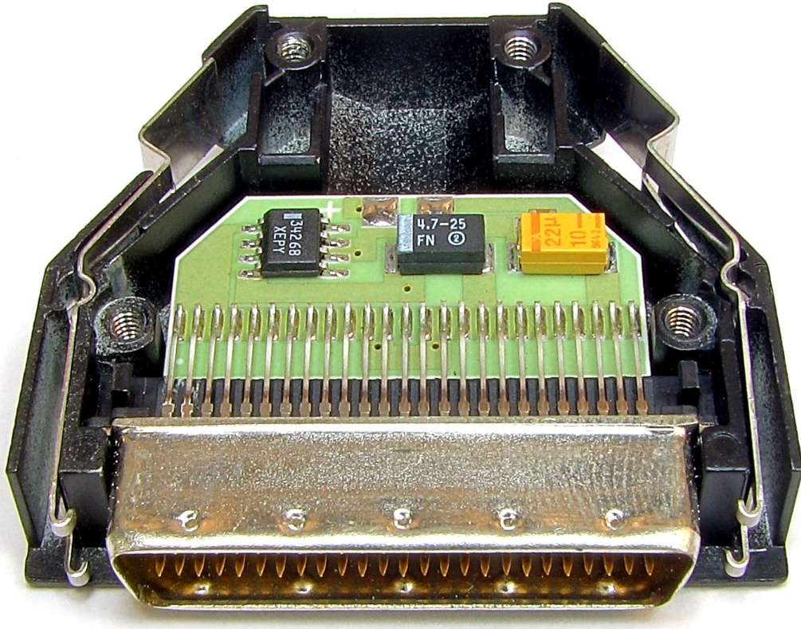
SCSI: Small Computer System Interface ( “Scuzzy”)
The SCSI standards define commands, protocols, electrical, optical and logical interfaces.
Parallel SCSI connectors
Bus terminator with top cover removed
Notes:
Clock skew (timing skew) is a phenomenon in synchronous digital circuit systems in which the same sourced clock signal arrives at different components at different times. The instantaneous difference between the readings of any two clocks is called their skew.

Slide 29
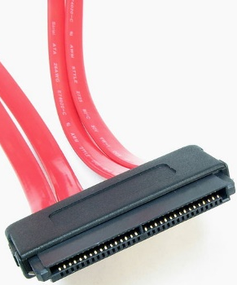
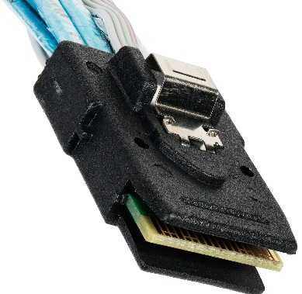
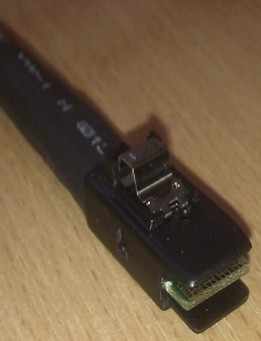
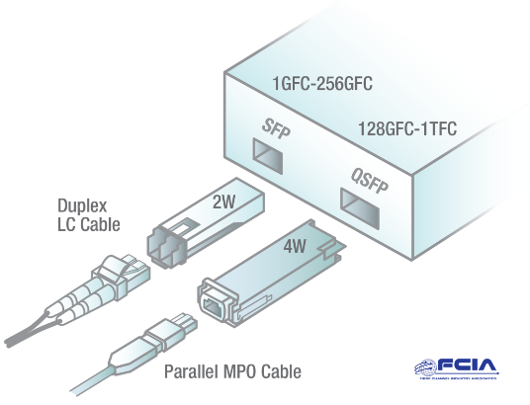
SCSI: Small Computer System Interface ( “Scuzzy”)
Modern SCSI
‌Break from the traditional parallel SCSI bus and perform data transfer via serial communications using point-to-point links.
Serial Attached SCSI (SAS)
SCSI-over-Fibre Channel Protocol (FCP)
USB Attached SCSI (UAS)‍
Notes:
Clock skew (timing skew) is a phenomenon in synchronous digital circuit systems in which the same sourced clock signal arrives at different components at different times. The instantaneous difference between the readings of any two clocks is called their skew.

Slide 30
SCSI: Small Computer System Interface ( “Scuzzy”)
Although much of the SCSI documentation talks about the parallel interface, all modern development efforts use serial interfaces.
Serial interfaces have a number of advantages over parallel SCSI, including
higher data rates,
simplified cabling,
longer reach,
improved fault isolation and
full-duplex capability.
Reason for the shift clock skew issue of high speed parallel interfaces,
makes the faster variants of parallel SCSI susceptible to problems caused by cabling and termination.
SAS 1.1 | 3 Gbit/s | 8b10b | 300 MB/s 2,400 Mbit/s
SAS 2.1 | 6 Gbit/s |  | 600 MB/s 4,800 Mbit/s
SAS 3.0 | 12 Gbit/s |  | 1,200 MB/s 9,600 Mbit/s
SAS 4.0 | 22.5 Gbit/s | 128b150b | 2,400 MB/s 19,200 Mbit/s
Notes:
Clock skew (timing skew) is a phenomenon in synchronous digital circuit systems in which the same sourced clock signal arrives at different components at different times. The instantaneous difference between the readings of any two clocks is called their skew.
All parallel SCSI units use terminators. SCSI is primarily used for storage and backup. An active terminator is a type of single ended SCSI terminator with a built-in voltage regulator to compensate for variations in terminator power.

Slide 31
NVM Express (NVMe)
NVM Express (NVMe) or Non-Volatile Memory Host Controller Interface Specification (NVMHCIS)
is an open, logical-device interface specification for accessing a computer's non-volatile storage media attached via PCI Express (PCIe) bus.
By its design, NVM Express allows host hardware and software to:
Fully exploit the levels of parallelism possible in modern SSDs.
As a result, NVM Express reduces I/O overhead and brings various performance improvements

Slide 32
PCI Express link performance
Version | Intro- duced | Line code | Transfer rate | Throughput
 |  |  |  | ×1 | ×2 | ×4 | ×8 | ×16
1.0 | 2003 | 8b/10b | 2.5 GT/s | 0.250 GB/s | 0.500 GB/s | 1.000 GB/s | 2.000 GB/s | 4.000 GB/s
2.0 | 2007 | 8b/10b | 5.0 GT/s | 0.500 GB/s | 1.000 GB/s | 2.000 GB/s | 4.000 GB/s | 8.000 GB/s
3.0 | 2010 | 128b/130b | 8.0 GT/s | 0.985 GB/s | 1.969 GB/s | 3.938 GB/s | 7.877 GB/s | 15.754 GB/s
4.0 | 2017 | 128b/130b | 16.0 GT/s | 1.969 GB/s | 3.938 GB/s | 7.877 GB/s | 15.754 GB/s | 31.508 GB/s
5.0 | 2019 | 128b/130b | 32.0 GT/s | 3.938 GB/s | 7.877 GB/s | 15.754 GB/s | 31.508 GB/s | 63.015 GB/s
6.0 (planned) | 2021 | 128b/130b + PAM-4 + ECC | 64.0 GT/s | 7.877 GB/s | 15.754 GB/s | 31.508 GB/s | 63.015 GB/s | 126.031 GB/s

Slide 33
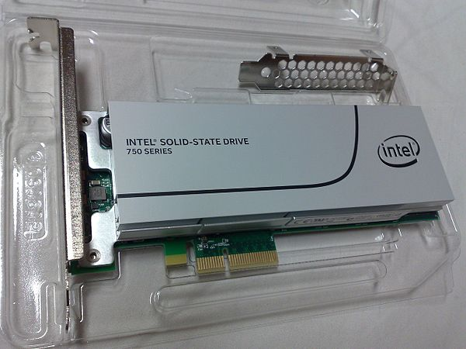
NVM Express (NVMe)
Intel SSD 750 series, an SSD that uses NVM Express, in form of a PCI Express 3.0 ×4 expansion card

Slide 34
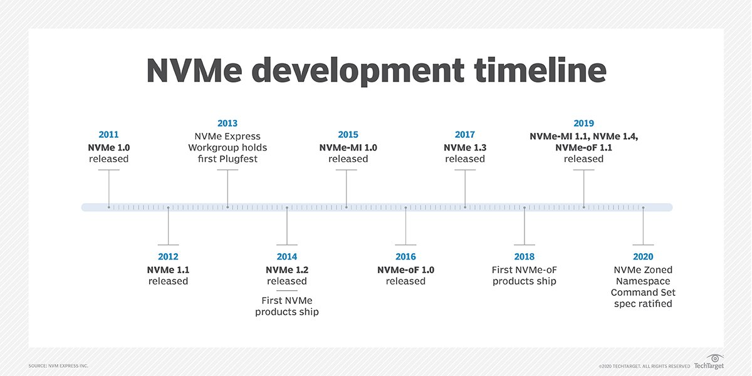
NVM Express (NVMe)
https://nvmexpress.org/

Slide 35
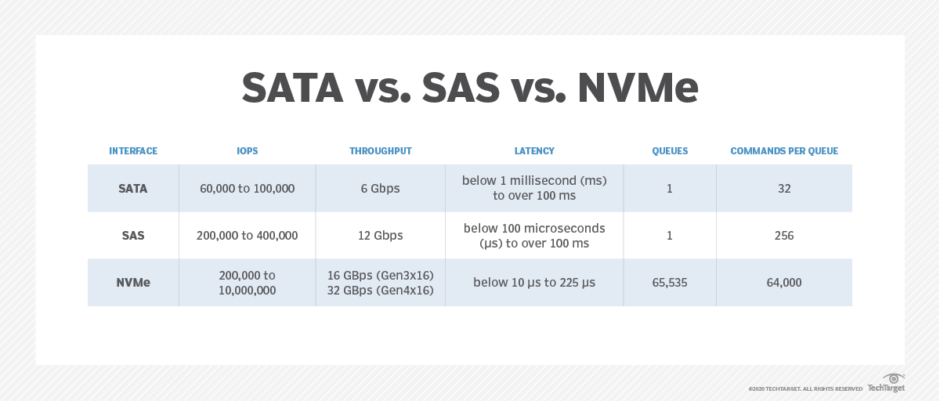
NVM Express (NVMe)
Notes:
IOPS (Input/Output Operations Per Second, pronounced i-ops) is a common performance measurement used to benchmark computer storage devices like hard disk drives (HDD), solid state drives (SSD), and storage area networks (SAN)

Slide 36
Storage Interfaces
Disk interface standards families
SATA (Serial ATA)
SATA 3 supports data transfer speeds of up to 6 gigabits/sec
SAS (Serial Attached SCSI)
SAS Version 3 supports 12 gigabits/sec
NVMe (Non-Volatile Memory Express) interface
Works with PCIe connectors to support lower latency and higher transfer rates
Supports data transfer rates of up to 24 gigabits/sec
Disks usually connected directly to computer system
In Storage Area Networks (SAN), a large number of disks are connected by a high-speed network to a number of servers
In Network Attached Storage (NAS) networked storage provides a file system interface using networked file system protocol, instead of providing a disk system interface

Slide 37
Optimization of Disk Block Access

Slide 38
Techniques for efficient data access
Data buffering
new data can be held in a buffer while old data is processed
Reading data ahead of request
blocks from the rest of the track can also be read even though they may not have been requested yet.
in anticipation that they will be requested soon
Use of log disks to temporarily hold writes
A disk devoted to writing a sequential log of block updates
Used exactly like nonvolatile RAM
Write to log disk is very fast since no seeks are required

Slide 39
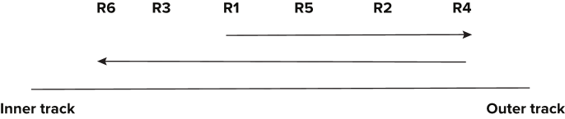
Techniques for efficient data access
Proper scheduling of I/O requests
Schedule so that the arm moves only in one direction and picks up the blocks along its movement.
Disk-arm-scheduling algorithms re-order block requests so that disk arm movement is minimized
Example:
Elevator Algorithm: mimics the behavior of an elevator that schedules requests on multiple floors in a proper sequence.

Slide 40
Techniques for efficient data access
File organization
Allocate blocks of a file in as contiguous a manner as possible
Files may get fragmented
E.g., if free blocks on disk are scattered, and newly created file has its blocks scattered over the disk
Sequential access to a fragmented file results in increased disk arm movement
Some systems have utilities to defragment the file system, in order to speed up file access
Notes:
keep related data on contiguous blocks

Slide 41
Techniques for efficient data access
Nonvolatile Write Buffers
Use of SSDs or flash memory for recovery purposes
involves writing the updates to a non-volatile SSD buffer, which may be a flash memory or battery-operated DRAM.
Both operate at must faster speeds.
The disk controller then updates the data file during its idle time and also when the buffer becomes full.
Writes can be reordered to minimize disk arm movement

